Slide 2


Mapping Hemochromatosis Genes using a Novel Recessive Diplotype Approach in the Marshfield Clinic Personalized Medicine Research Project (PMRP)
Shicheng Guo
Center for Precision Medicine Research
Marshfield Clinic Research Institute
03/13/2019

Slide 3
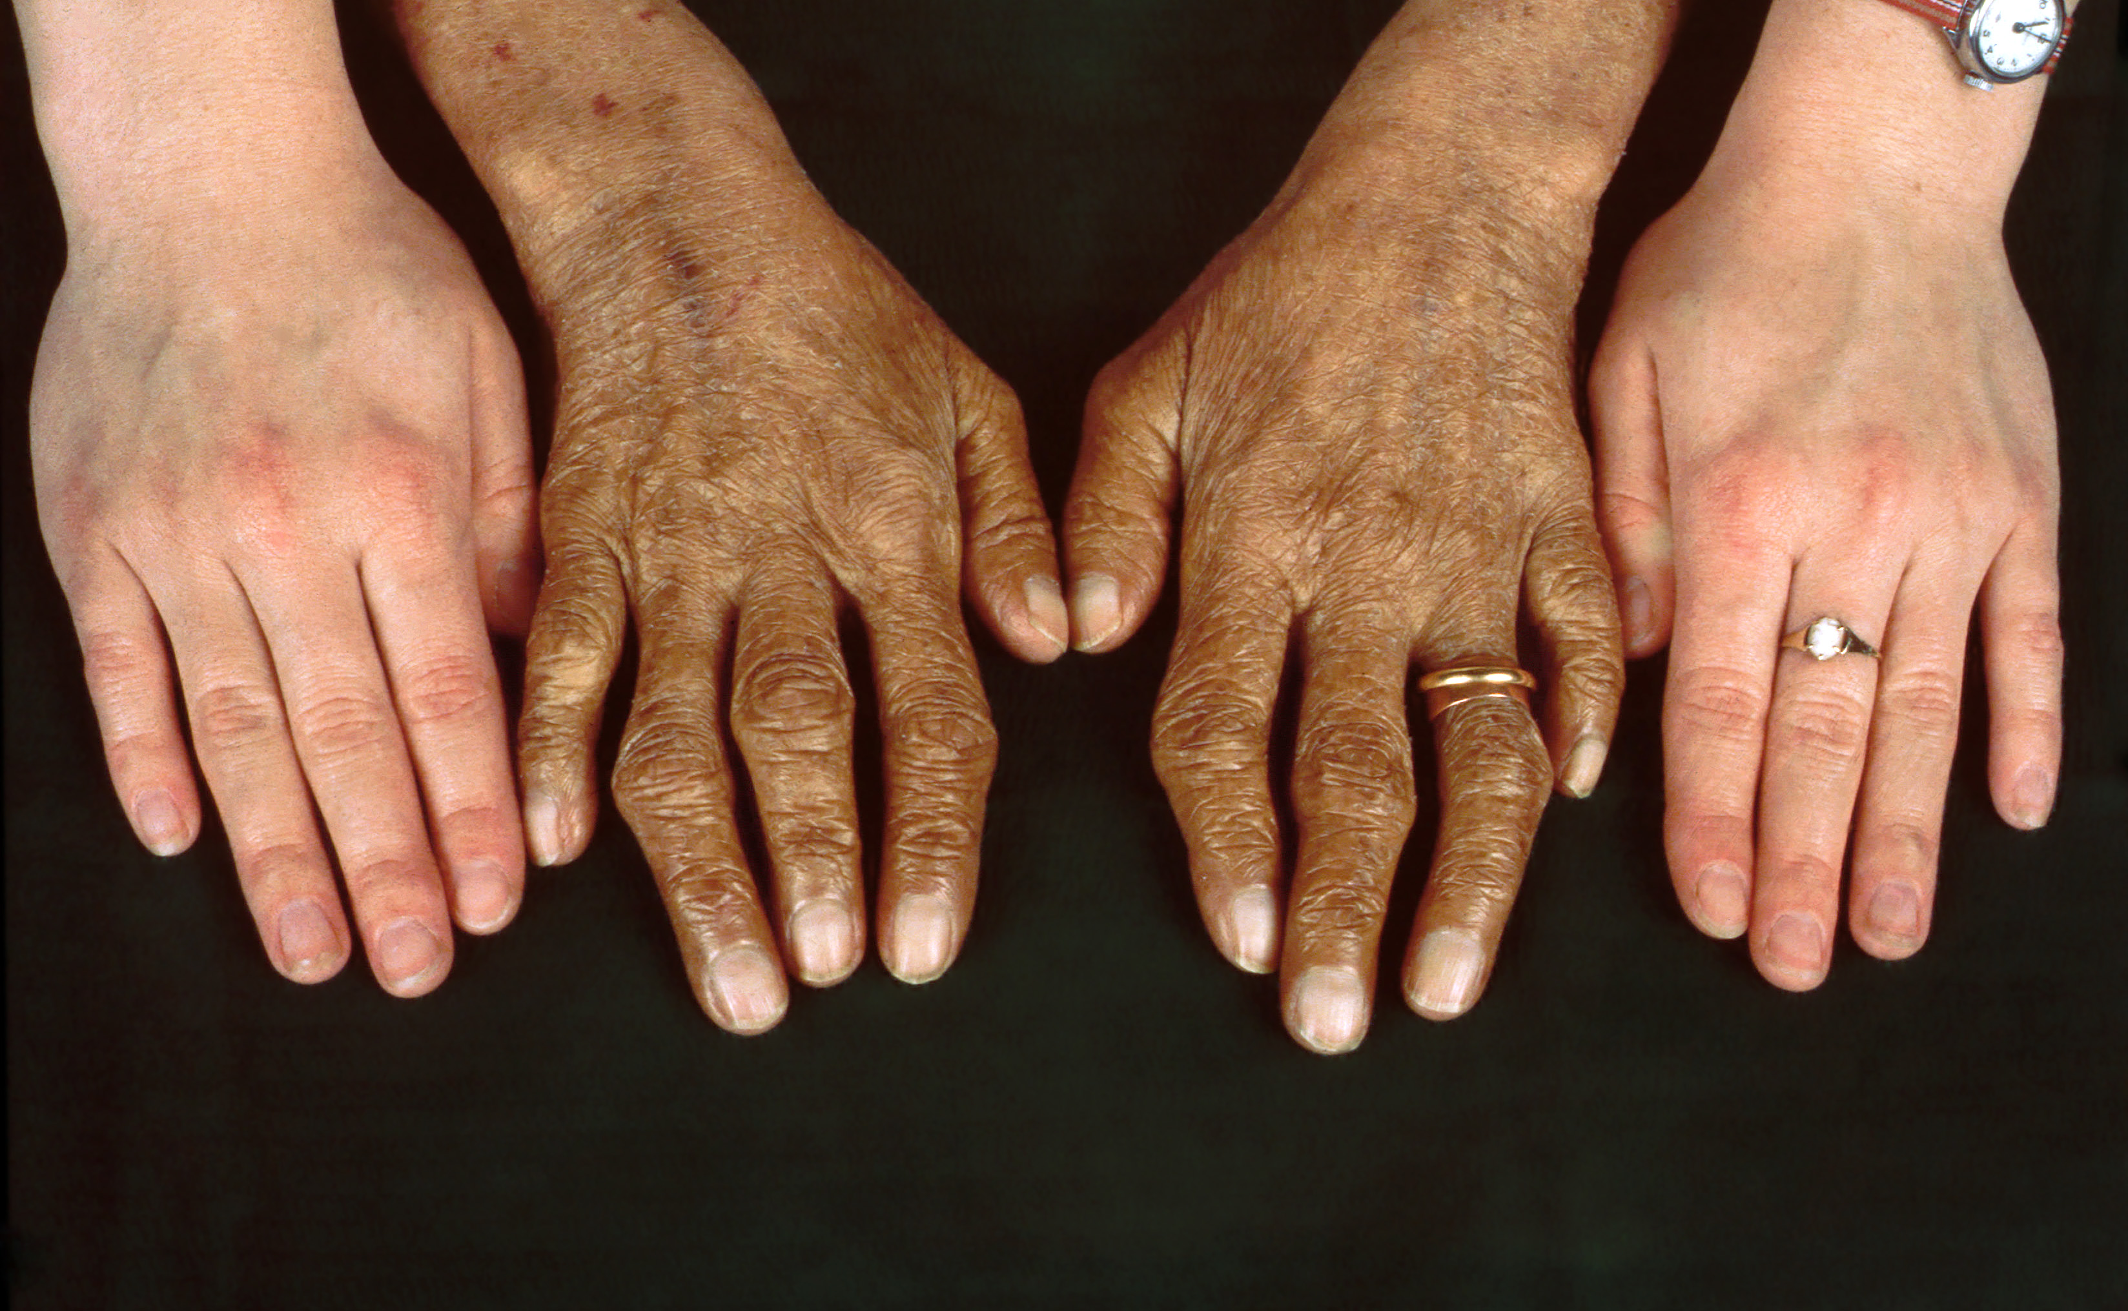
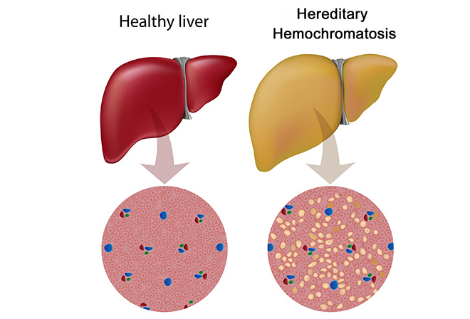
Hemochromatosis: clinical symptoms
Hereditary hemochromatosis (HH) is a genetic disorder characterized by excessive iron accumulation that results in multiple tissues damage
Skin bronzing or hyperpigmentation (70%)
Liver disease (hepatomegaly, 13%; cirrhosis, 13%)
Diabetes mellitus (48%)
Arthropathy
Amenorrhea, impotence, hypogonadism
Grey’s Anatomy: https://www.youtube.com/watch?v=H4SAK7vgfUo
Notes:
Hereditary hemochromatosis is a genetic disorder characterized by excessive iron (Fe) accumulation that results in tissue damage. Manifestations can include systemic symptoms, liver disorders, cardiomyopathy, diabetes, erectile dysfunction, and arthropathy. Diagnosis is by elevated serum ferritin, iron, and transferrin saturation levels and confirmed by a gene assay. Treatment is usually with serial phlebotomies. The most common clinical symptoms are skin bronzing and liver diseases.

Slide 4
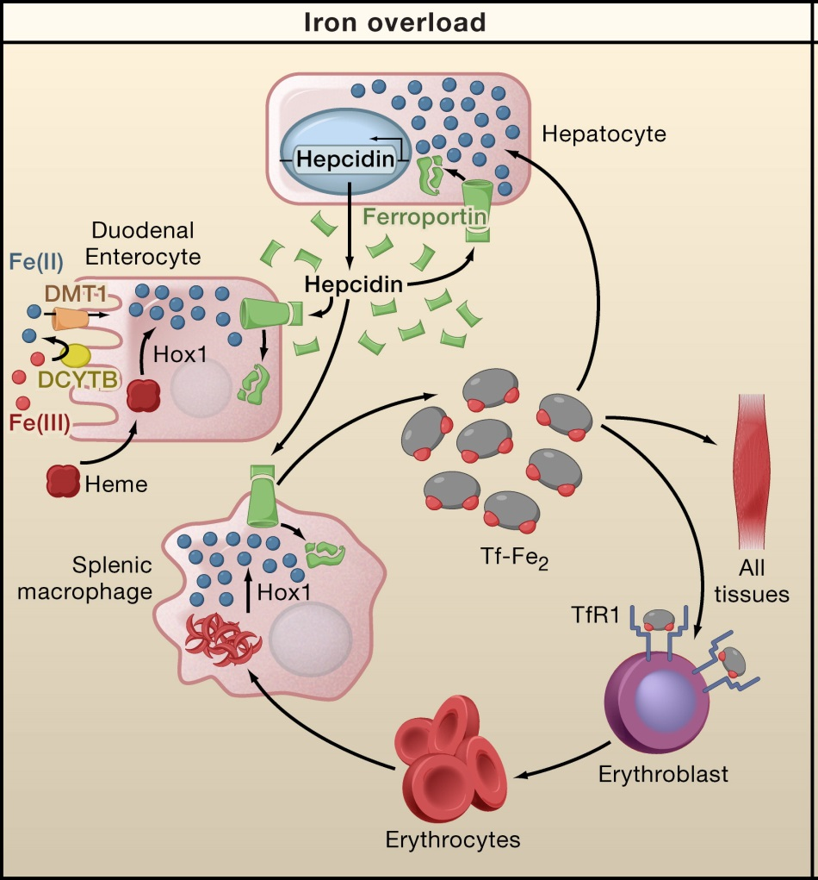
Human iron metabolism and iron homeostasis
Liver cells
Storage and Regulation
HAMP
Intestinal mucosal cells
Iron Absorption
SLC40A1
Blood Cells
Storage and Transport

Slide 5
Genetic etiology of hemochromatosis
 | Type 1 | Type 2A | Type 2B | Type 3 | Type 4
Name | Classic HHC | Juvenile HHC | Juvenile HHC | TfR2-related HHC | Ferroportin-related iron overload
Gene | HFE | HJV | HAMP | TfR2 | SLC40A1
Protein Produced | HFE | Hemojuvelin | Hepcidin | Transferrin receptor 2 | Ferroportin (iron regulatory protein)
Inheritance | autosomal recessive | autosomal recessive | autosomal recessive | autosomal recessive | autosomal dominant
Function | interruption of transferrin-bound iron, possible modulation of hepcidin regulation | unknown; possible hepcidin modulation | regulation of iron release in intestinal and blood cells | possible interference of iron uptake by liver cells | possible interference of iron export from intestinal, liver and placental cells
Organ Damage | variable | high | high | variable | low
Age of Onset | 40s or 50s | 20s or 30s | 20s or 30s | 40s or 50s | 40s or 50s

Slide 6
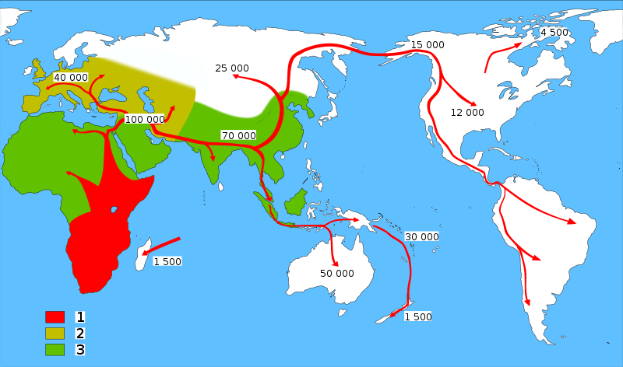
HFE-Hemochromatosis and Human migrations
Neolithic Agricultural Revolution
C282Y ~6000
HFE C282Y, ~6000 years ago
85–90%: Northern European Descent
60%: Mediterranean populations
0% in Asian population
The C282Y allele is the major cause of hemochromatosis as a result of excessive iron absorption. The mutation arose in continental Europe no earlier than 6,000 years ago, coinciding with the arrival of the Neolithic agricultural revolution.
Tsui WM, et al. The C282Y mutation of the HFE gene is not found in Chinese haemochromatotic patients: multicentre retrospective study. Hong Kong Med J 2000;6:153-158.

Slide 7
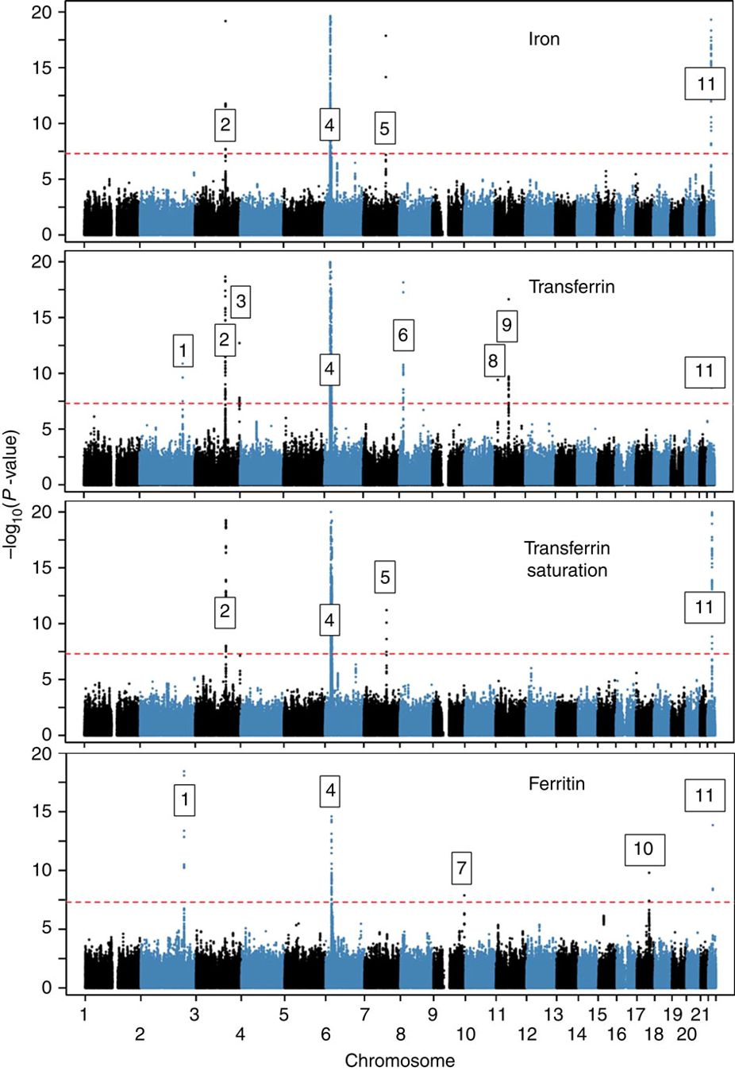
Novel loci affecting iron homeostasis and their effects in individuals at risk for hemochromatosis
HFE, HJV, HAMP, TFR2, SLC40A1
In 2014, Benyamin and colleagues: GWAS
Discovery: 23,986 samples
Validation: 24,986 samples
11 genome-wide-significant (P<5 × 10−8) loci, some including known iron-related genes (HFE, SLC40A1, TF, TFR2, TFRC, TMPRSS6) and others novel (ABO, ARNTL, FADS2, NAT2, TEX14).
Limitation: conventional statistic models
Benyamin B, Esko T, Ried JS, Radhakrishnan A, Vermeulen SH, Traglia M, Gogele M, et al. Novel loci affecting iron homeostasis and their effects in individuals at risk for hemochromatosis. Nat Commun 2014;5:4926.

Slide 8
Exome-wide, Gene-based Recessive Diplotype Scan
Single Site Recessive Effects
Recessive Diplotype
site by site
region by region
Gene-by-Gene Scanning to Identify Disease Genes

Slide 9


Recessive Diplotype Scan
Power calculations
2-locus model
Gene-based Monte Carlo
using 1000 Genomes
P₁₁
P₁₂
P₂₁
P₂₂
P₁₂ | P₁₂
P₁₁ | P₁₁
P₁₂ | P₂₁
P₁₁ | P₁₂
$$P\left(Disease | Diplotype\right)$$
$$small$$
P₁₂ | P₂₂
$$P\left(Disease | Diplotype\right)$$
$$large$$
P₁₁ | P₂₁
P₂₁ | P₂₁
P₁₁ | P₂₂
P₂₁ | P₂₂
P₂₂ | P₂₂

Slide 10
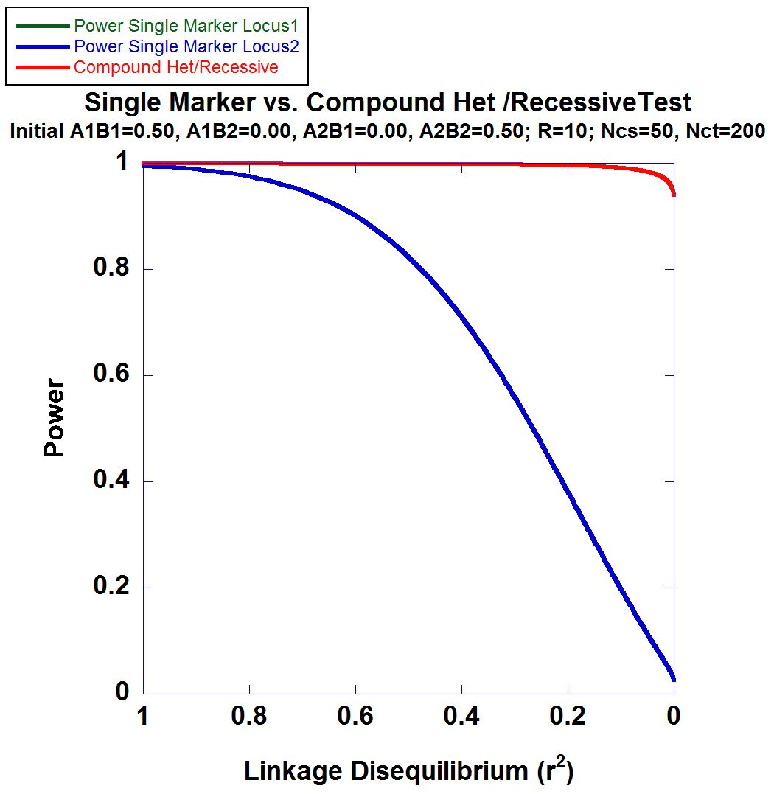
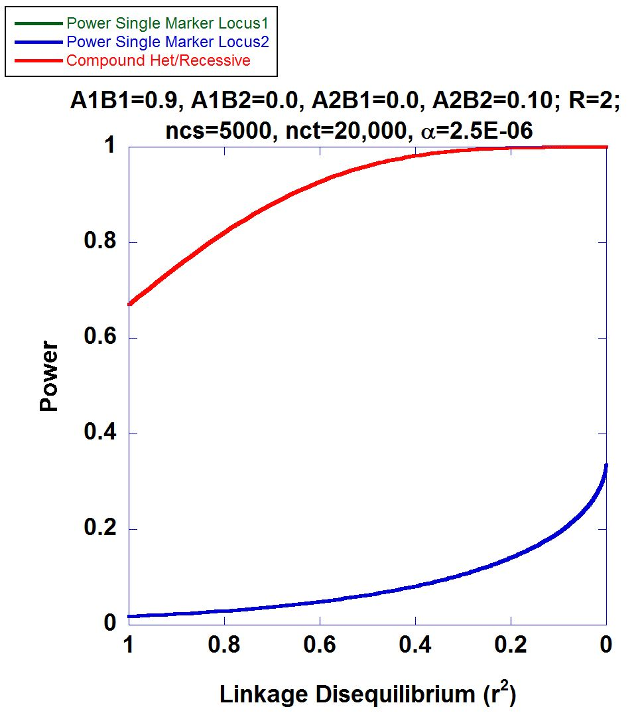
2-locus Power Calculations

Slide 11
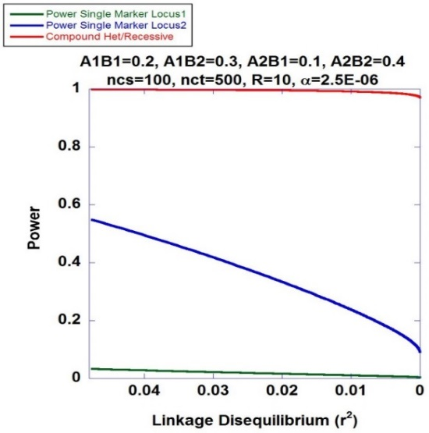
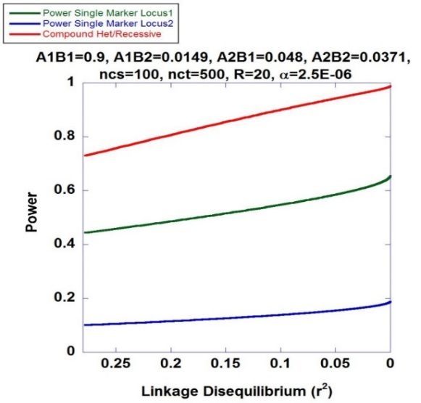
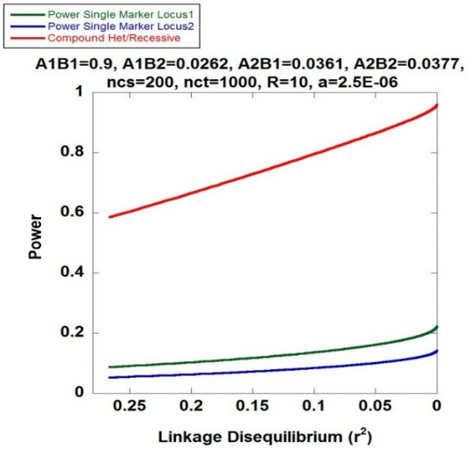
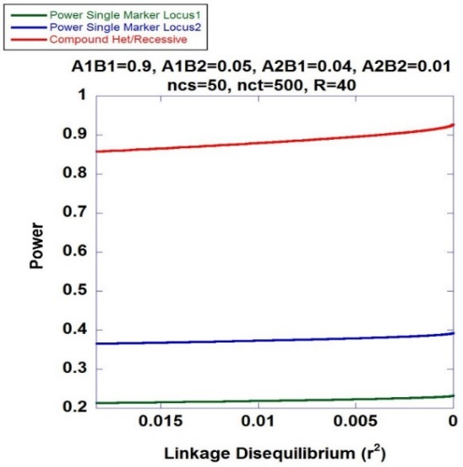
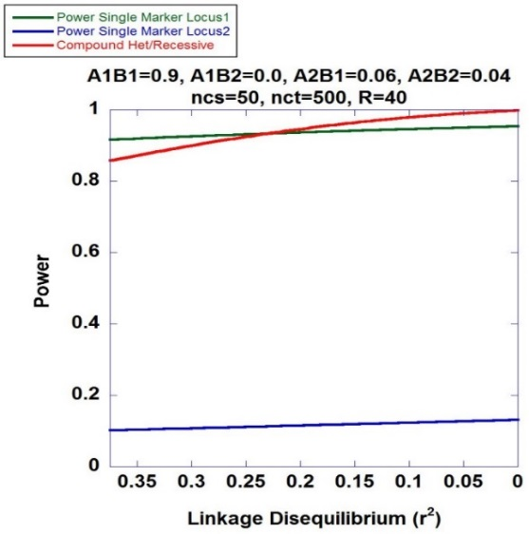
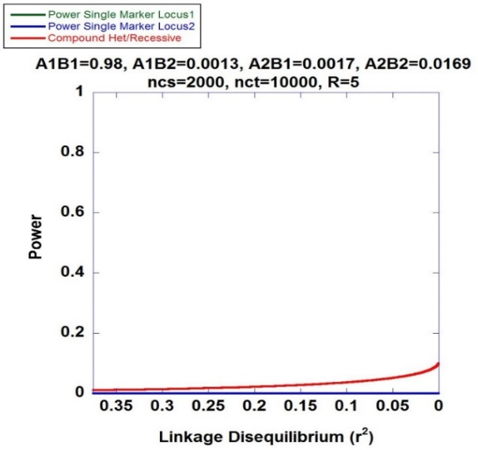
Higher Power of Recessive Diplotype Scan benefits PMRP
Recessive Diplotype approach always has higher power to identify the associated variants

Slide 12
Mapping Hemochromatosis Genes using a Novel Recessive Diplotype approach in PMRP
Exome beadchip data used on 10,000 subjects
PCA used to exclude genetic background outliers
Phasing using localized haplotype clustering
Putative functional variants: GWAS-significant, nonsynonymous, 3’UTR, 5’UTR, or splice site
Two or more in silico pathogenic annotations
ICD9: two or more instances of (i) iron metabolism disorder (ii) hereditary hemochromatosis, (iii) unspecified hemochromatosis
Transferrin saturation (ratio of serum iron to transferrin iron-binding capacity) > 48%
18 cases identified and 6,896 controls

Slide 13
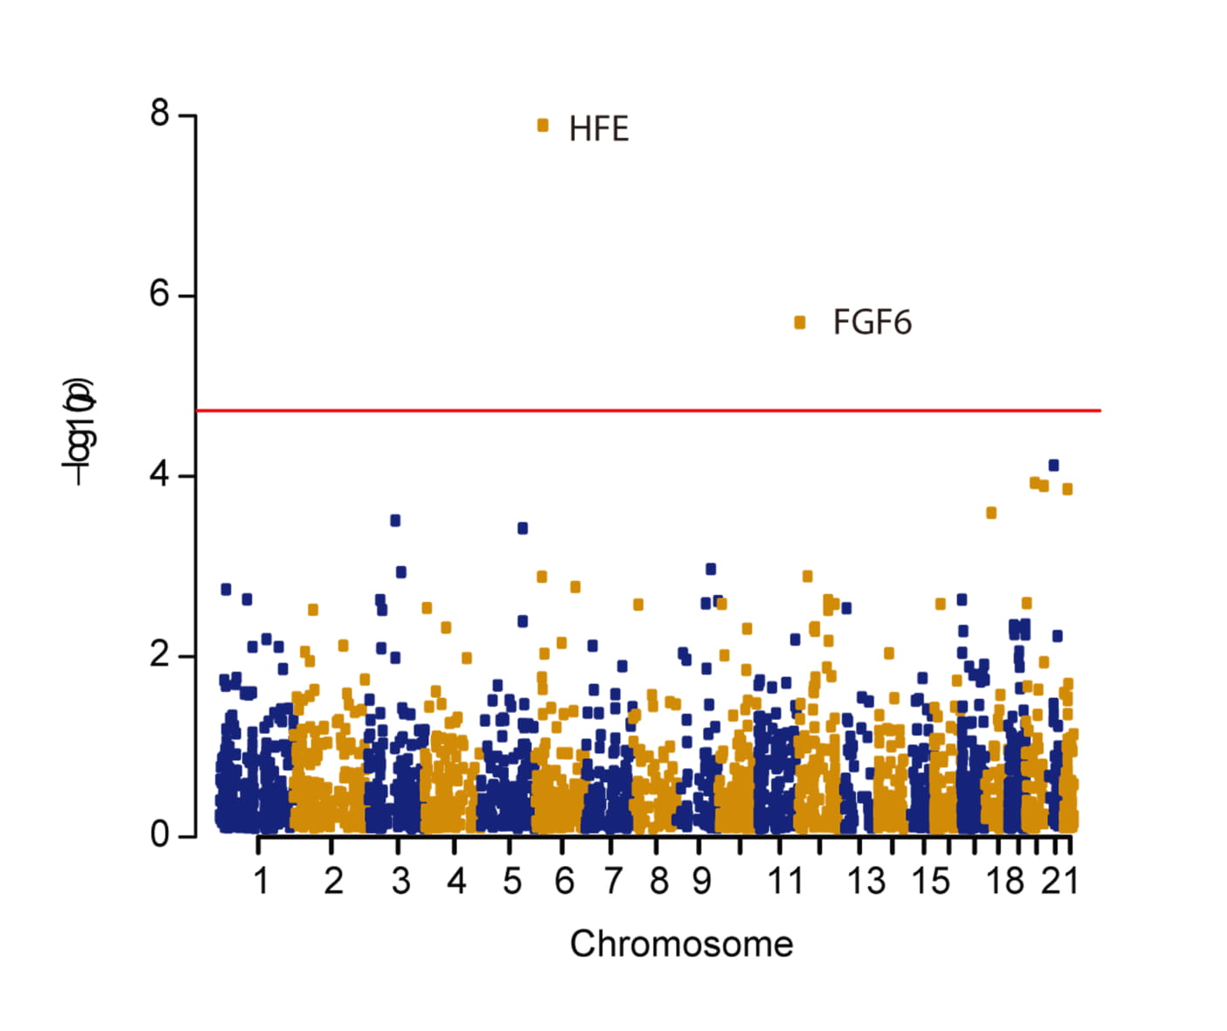
Manhattan Plot
CHR | GENE | P | OR#
chr6 | HFE | 1.29×10⁻⁸ | 28.6
chr12 | FGF6 | 1.99×10⁻⁶ | 22.8
chr21 | KRTAP15-1 | 7.55×10⁻⁵ | 6.78
chr20 | XKR7 | 1.18×10⁻⁴ | 43.6
chr20 | CABLES2 | 1.28×10⁻⁴ | 42.4
chr22 | THOC5 | 1.38×10⁻⁴ | 6.24

Slide 14
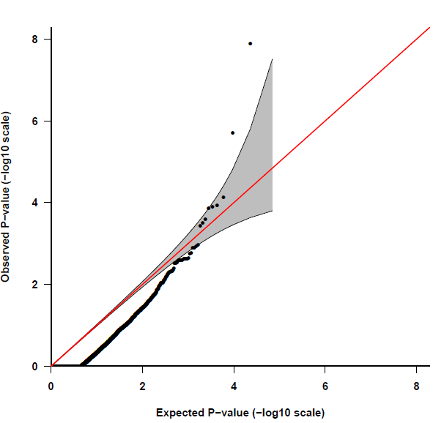
Quantile-Quantile Plot
HFE
FGF6
Fibroblast Growth Factor 6
Heparin-Binding Growth Factor 6
Heparin Secretory-Transforming Protein 2
FGF6
Poli M, Girelli D, et al. Heparin: a potent inhibitor of hepcidin expression in vitro and in vivo. Blood 2011;117:997-1004.

Slide 15
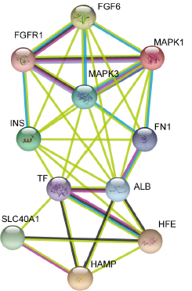
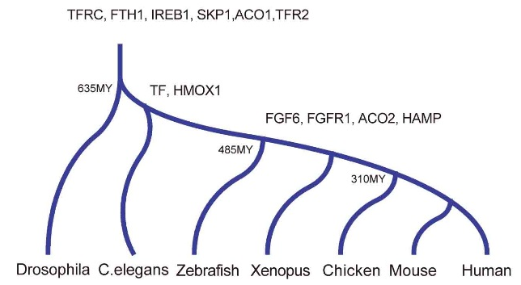
FGF6: molecular evolution and biological function
Encodes for the fibroblast growth factor 6 protein
Expressed across numerous tissues including skeletal muscle,
blood, liver and pancreas
Stage I: fundamental genes
Stage II: Regulatory Genes
Protein-protein interactions suggest
involvement of FGF-6 with Fe-metabolism
subnetwork

Slide 16
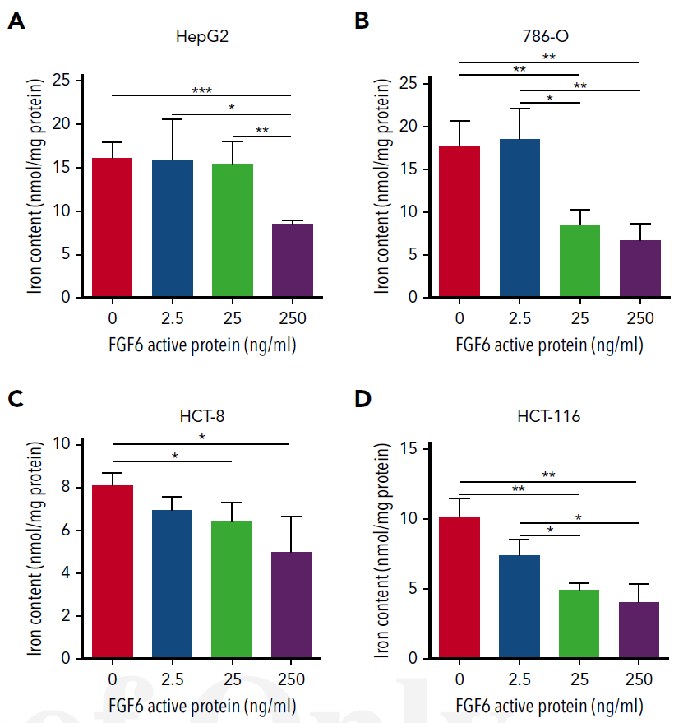
Dose-Dependent FGF-6 Impact on Intracellular Iron

Slide 17
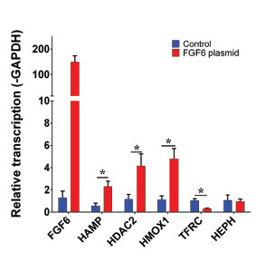
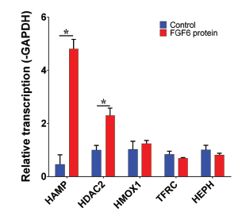
FGF-6 and FGF6 Transcriptional Regulation of Hepcidin (HAMP) in Hepatocytes
HAMP encodes for hepcidin
HDAC2 encodes for histone deacetylase 2
HMOX1 encodes for heme oxygenase 1
TFRC encodes for transferring receptor 1
HEPH encodes for hephaestin
Confirmed: FGF-6 could transcriptional regulate of Hepcidin (HAMP) in Hepatocytes
What is the biological Function of each variants?

Slide 18
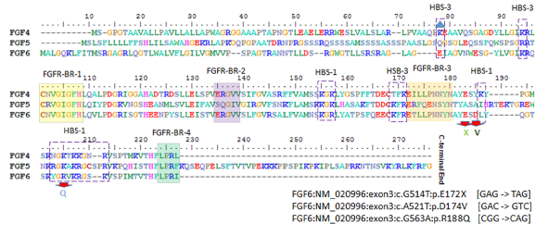
Evaluation of Three FGF6 Nonsynonymous Putative Functional Variants
Within or adjacent to heparin binding site motifs

Slide 19
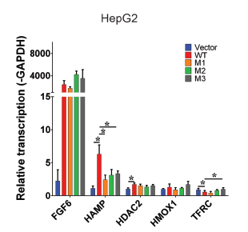
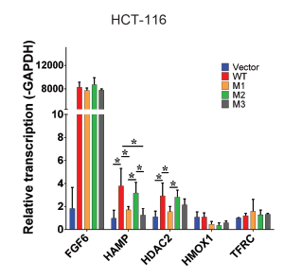
Variants Show Attenuation of Hepcidin Transcription Compared to Wildtype
M1: E172X
M2: D174V
M3: R188Q
Transfect FGF6 and variants into different cell lines

Slide 20
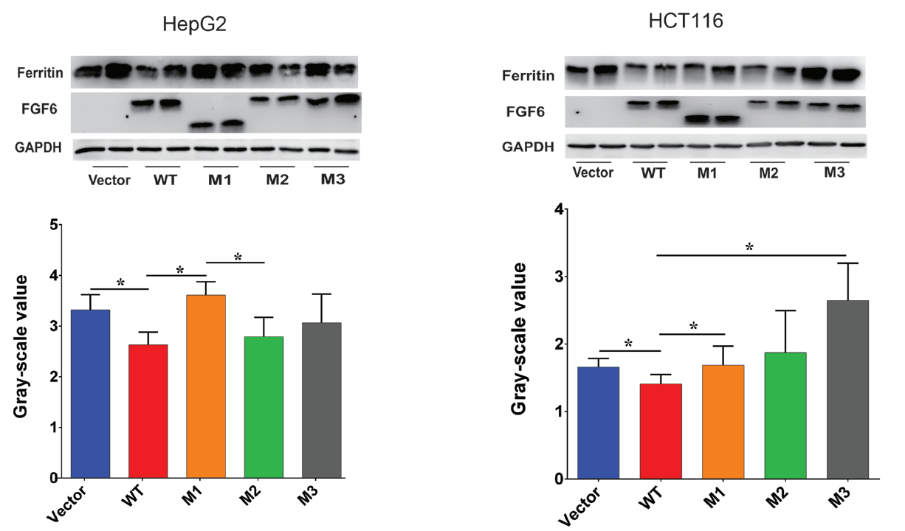
Variants Show Reduced Attenuation of Iron Uptake

Slide 21
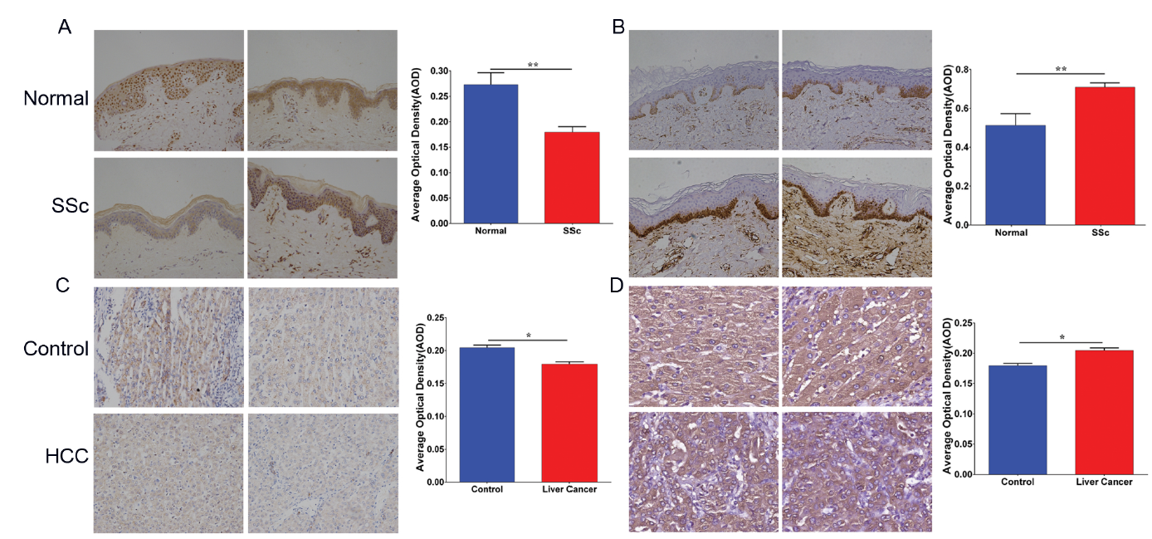
Low FGF6 expression and high iron deposition in liver cancer and systemic sclerosis (Immunohistochemistry, IHC)
FGF-6 protein level
Ferritin protein level

Slide 22
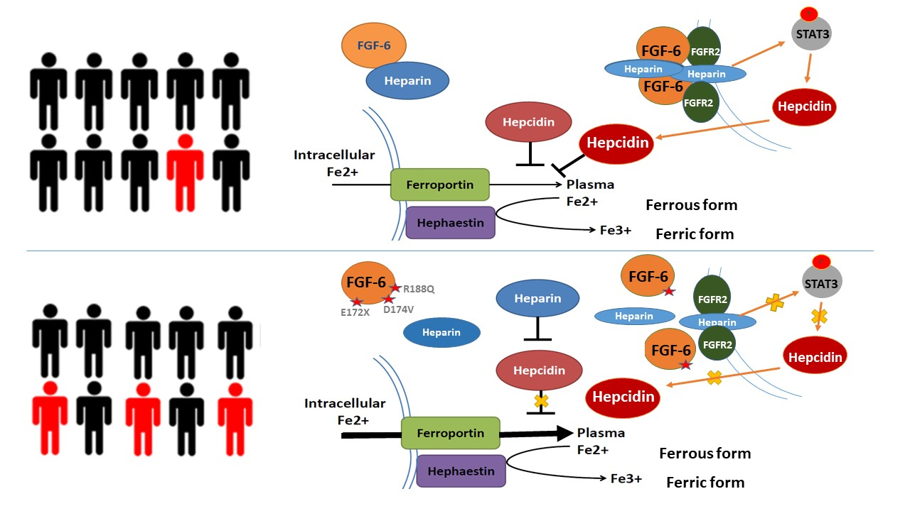
Marshfield Model: FGF6 decreases ferrous iron uptake in liver cells and induces increased hepcidin expression

Slide 23
Research contribution to clinical
 | Type 1 | Type 2A | Type 2B | Type 3 | Type 4
Name | Classic HHC | Juvenile HHC | Juvenile HHC | TfR2-related HHC | Ferroportin-related iron overload
Gene | HFE | HJV | HAMP | TfR2 | SLC40A1
Protein Produced | HFE | Hemojuvelin | Hepcidin | Transferrin receptor 2 | Ferroportin (iron regulatory protein)
Inheritance | autosomal recessive | autosomal recessive | autosomal recessive | autosomal recessive | autosomal dominant
Function | interruption of transferrin-bound iron, possible modulation of hepcidin regulation | unknown; possible hepcidin modulation | regulation of iron release in intestinal and blood cells | possible interference of iron uptake by liver cells | possible interference of iron export from intestinal, liver and placental cells
Organ Damage | variable | high | high | variable | low
Age of Onset | 40s or 50s | 20s or 30s | 20s or 30s | 40s or 50s | 40s or 50s
Type 5
FGF6-related iron overload
FGF6
Hepcidin and FGF6
CH recessive
?
?
?
1. Identified a new substype of hemochromatosis
2. More understanding to hemochromatosis
3, potential drug targets for the therapy of hemochromatosis

Slide 24
Thanks

